Slide 1

ELL Leadership Academy
Karina E. Chapa, M.Ed.
Language Proficiency, Biliteracy
and Cultural Diversity Director
kchapa@esc1.net

Slide 2

Professional Learning Essential Agreements
Be respectful of others
Be an active participant
Take care of your needs
Use electronic devices as learning tools

Slide 3

Edmodo Code: cjqnik
Post a comment on one idea that called your attention from Chapter 4.
Respond to least one person’s comment.
www.edmodo.com

Slide 4
AGENDA
Acceleration vs Remediation
Meeting the Needs of ELLs in GT Programs
Meeting the Needs of ELLs in Special Education
Program EffectivenessPBMAS

Slide 5
2017 PBMAS
Performance Based Monitoring Analysis System

Slide 6
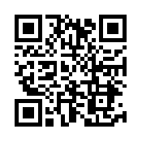
PBMAS Reports
https://goo.gl/RKDUya

Slide 7
Special Education
NCLB Title I Part A At Risk
Program Performance
&
Program Effectiveness
Bilingual ESL
NCLB Title I Part C Migrant
CTE

Slide 8
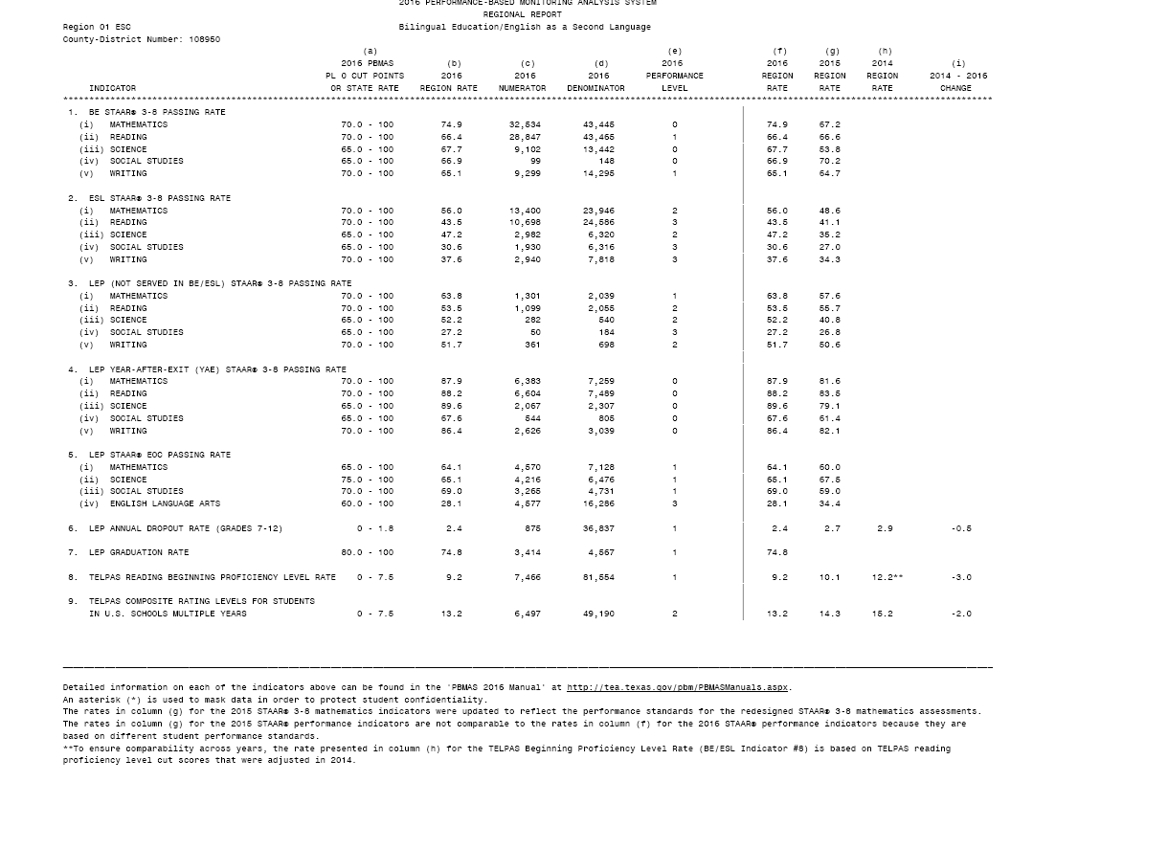
BE/ESL (Indicators 1-9)
ELLs are advancing academically as per STAAR performance
ELLs Not Served in BE or ESL are advancing academically as per STAAR performance
ELLs are graduating and not dropping out of school
ELLs grades 2-12 are not scoring beginning proficiency level for two consecutive years on TELPAS Reading
ELLs grades 5-12, 5 + years demonstrate progress on TELPAS Composite rating and are not continuing to be rated B or I

Slide 11
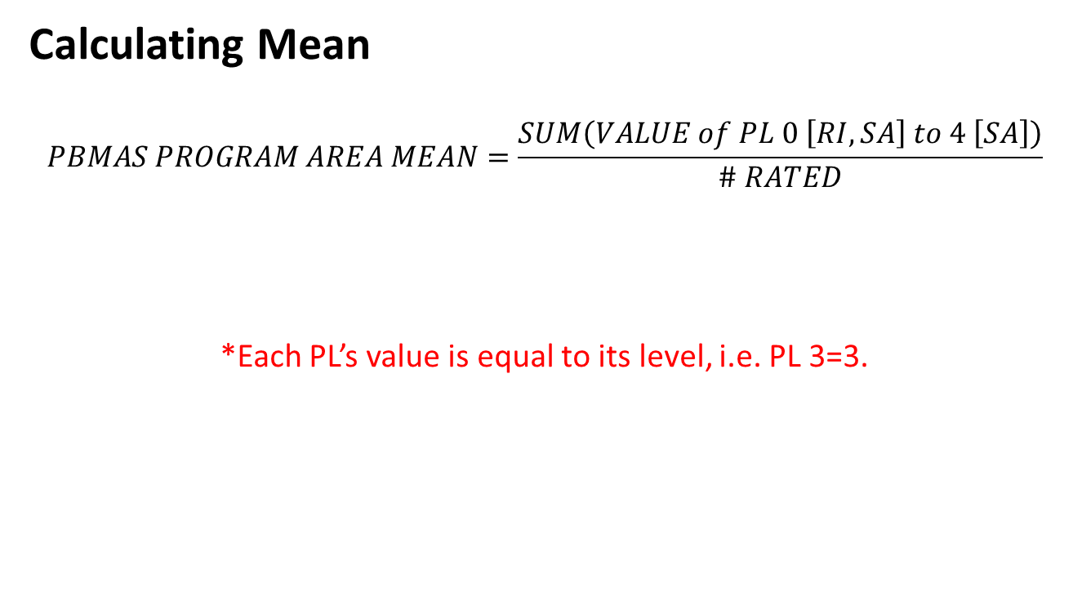
2017 Staging Framework

Slide 12
2017 Staging Framework
Mean Ranges by Program Area for a 90%/10% Distribution
STAGE | BE/ESL | CTE | ESSA | SPED
1 | 0.2 – 1.2 | 0.2 – 0.8 | 0.2 – 0.9 | 0.1 – 1.3
2 | 1.3 – 1.7 | 0.9 – 1.3 | 1.0 – 1.5 | 1.4 – 1.5
3 | 1.8 – 2.0 | 1.4 – 1.5 | 1.6 – 2.2 | 1.6 – 1.8
4 | 2.1 – 3.2 | 1.6 – 2.4 | 2.3 – 3.0 | 1.9 – 2.2

Slide 13
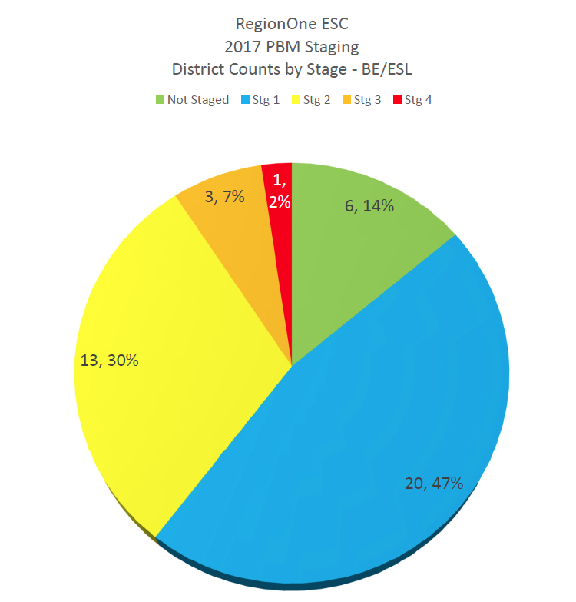
Notes:
11:15 AM

Slide 14
Data
Process
Reporting
State
Districts & Campuses
IR or Met Standard
Indexes & Safeguards
Data Analysis
Needs Assessment
Targeted Improvement
Plan with
Progress Reports
Federal (ESEA Waiver)
Districts & Campuses
Priority and Focus
Safeguards
Implement & Monitor
Improvement Plan
Performance-Based Monitoring (PBM)
Districts
PBMAS
Notes:
Presenter Talking Points:
The continuous improvement process has been designed in such a way that regardless of what accountability rating initiates the engagement to the framework, the continuous improvement process is universally applicable in getting the work done in a targeted way.
Optional Activity: Before the break, give teams a couple minutes to write down or discuss 1 question they may have swirling around at this point and 1 thing that is square in their thinking.
Optional Activity: Share out could be used as a way to welcome group back from the break.

Slide 15

Data Analysis
WHAT
Needs Assessment
WHY
Implement & Monitor
Improvement Plan
HOW
DATA ANALYSIS
Notes:
Facilitator Talking Points:
As mentioned in the opening, the purpose of this training is not to review all required interventions, rather to focus on the most important aspect of the work: engaging in the TAIS continuous improvement process.
Now we are going to take a look at the first quadrant of the continuous improvement process, data analysis.

Slide 16
Steps for Data Analysis
1. Create Inventory of Data Sources
2. Analyze Trends and Patterns
3. Identify the Problem Area
4. Create a Problem Statement
5. Verify Problem Statement

Slide 17

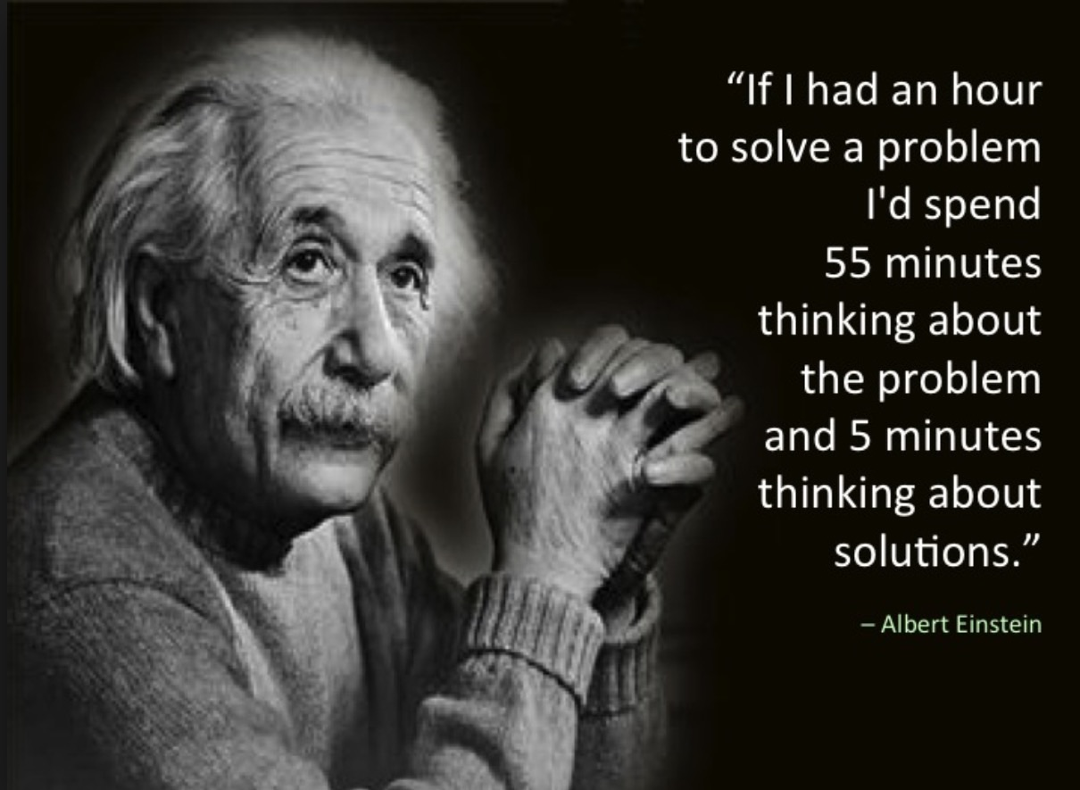
“A problem properly stated is half solved.”
John Dewey
Notes:
Facilitator Talking Points:
Provide the participants time to read this quote. Then inform them that as we move through each section, especially data analysis and needs assessment, the underlying message in this quote w section think about what this quote means to each step in the continuous improvement process.
Facilitation Notes:
Provide the participants time to read this quote.

Slide 18
A well written problem statements is…
Criteria | Y/N
Substantiated by facts/data
Written objectively
Uses concise language
Includes specific details (who, what, when, where)
Focuses on a single, manageable issue
Has relevance to our campus
Avoids causation or assigning solutions
Notes:
Facilitator Talking Points:
To help support the development of a problem statement, the following check list may also be used with your team. Notice that the criteria maintain objective and factual. Again, at this point, we are only exploring what the problems are.
Being that the requirement to develop a targeted improvement plan is to focus on the areas of low performance, it’s possible that teams may only identify 2-3 problem statements.
Keep in mind that, the rest of the plan will be developed further once the problem statements have been generated. At this point in the process you are bringing clarity to what issues need to be addressed in your plan.
Refer to the Problem Statement Checklist handout. This is a resource that you can use in the development of your problems statements.
With this criteria in mind, let’s review a sample problem statement to see if it is well written.
Facilitation Notes:
Have participants access the problem statement checklist
Reiterate that this practice is to become very clear about WHAT the problem are is, not why or how to address it.
Give teams time to review each criteria
Handout 7: Problem Statement Checklist

Slide 19

PROBLEM STATEMENT QUALITY CHECK
ELLs have a 50% pass rate in reading due to a lack of parental involvement
Notes:
Facilitator Talking Points:
Explain that as a group, you will assess the above problem statement according to the criteria in the tool.
Ask that the group help as you assess the problem statement according to each piece of the criteria by giving a “thumbs up,” “thumbs down,” or something in between.
Tell them that the end goal will be to produce an even better problem statement.

Slide 20
PROBLEM STATEMENT QUALITY CHECK
ELLs have a 50% pass rate in reading due to a lack of parental involvement
ELLs have a 50% pass rate in reading
REVISED PROBLEM STATEMENT
Notes:
Facilitator Talking Points:
Here is an example of a revised problem statement that addresses the criteria that were not followed previously.
Perhaps quickly run the new problem statement through the criteria to illustrate – especially highlight no causation and one manageable issue.
Facilitation Notes:
Encourage sharing out, if appropriate.
If the group does not raise the point, explain that when we see the words “due to,” we are assigning blame.
OPTIONAL ACTIVITY
Perhaps give the group some time to re-write the problem statement using the lessons learned from the criteria tool. Have them share out what they came up with. Allow the group to assess each one that is shared.
(7-10min)

Slide 21
Data Analysis
WHAT
Needs Assessment
WHY
Implement & Monitor
Improvement Plan
HOW
NEEDS ASSESSMENT
Notes:
Facilitation Notes:
Transition slide for next step in the process.

Slide 22
Steps for Needs Assessment
Root Cause Analysis
Additional Data Sources
Select Root Cause

Slide 23

WHY?
Notes:
Facilitator Talking Points:
The purpose of the root cause analysis is to identify possible reasons WHY the problem is occurring. Digging beneath the surface of the common assumptions that are often made when attempting to fix the problems we see. Understanding the root cause will lead to a more effective plan that addresses the real issues and is not based on assumptions.
Once we have analyzed the data and gained a clear understanding of what the data says through the development of problem statements, we can effectively begin to drill into WHY these problems exist. The needs assessment, or root cause analysis, will help us understand WHY the problems, or gaps in data, exist.
The root cause is significant because it helps answer WHY the problem (or gap based on data) exists. Determining a reason WHY a gap exists, especially one that isn’t an obvious reason why, gives us insight as to HOW best to address the problem in the planning phase of the process.
The root cause is a hypothesis for the problem statement. This hypothesis sets the context for us to treat the deeper issues, below the surface of the problem statement. This hypothesis is a data grounded, proposed reason why this problem is occurring. However, there are no absolutes when it comes to determining whether or not the “right” root cause has been identified.
The root cause analysis process allows one to drill deep below the surface reasons why. Drilling deep enough helps better identify the root cause, thus allowing us to select the best possible strategy later in the process.
Facilitator Note:
Acknowledge those who may already work with a root cause analysis process.

Slide 24
ROOT CAUSE ANALYSIS PROCESS
PROBLEM STATEMENT
ACTION 1:
  10, 5, 5
ACTION 2:
  Control vs No Control
ACTION 3:
  5 Whys
ROOT CAUSE
Notes:
Facilitator Talking Points:
The first phase of this analysis is called the 10, 5, 5
10, 5, 5---This is a group brainstorming process meant to begin conversations around the possible reasons WHY the problems or gaps exist.
This process establishes multiple hypothesis to a given problem statement.
The purpose of this activity is to stretch brainstorming beyond the surface level or common reasons “why.”
In a minute, starting with the drafted problem statement written on your poster, you’re going to be given time individually to come up with a list of reasons why the problem is occurring AND THEN YOU WILL BE GIVEN TIME TO WORK WHOLE GROUP TO COMBINE YOUR POSSIBLE REASONS WHY THE GAP EXISTS.
There are no wrong answers so record whatever possible reasons come to mind that problem is occurring. However, it’s important to note that data will need to be referenced in order to avoid subjectivity and opinion based reasons moving forward.
Handout 8: Root Cause Analysis activity

Slide 25
ROOT CAUSE ANALYSIS PROCESS
PROBLEM STATEMENT
ACTION 1:
  10, 5, 5
ACTION 2:
  Control vs No Control
ACTION 3:
  5 Whys
ROOT CAUSE
Notes:
Facilitator Talking Points:
Often times we expend energy in solving issues that are beyond our direct control but perhaps we still have influence over.
In order to make urgent changes that have a strong impact, we want to focus our attention on what we can directly control.
So, in this next phase, you will sort through the list of 20 reasons and begin to decide which of those ideas can we control and which might we only have an influence over.

Slide 26
ROOT CAUSE ANALYSIS PROCESS
PROBLEM STATEMENT
ACTION 1:
  10, 5, 5
ACTION 2:
  Control vs No Control
ACTION 3:
  5 Whys
ROOT CAUSE
Notes:
Facilitator Talking Points:
The last phase to this process is called 5 Whys.
Once a consensus has been reached, the 5 Whys will provide an opportunity for teams to dig deeper into why the problem is occurring.
The last answer to the last question becomes the possible root cause.
Know that 5 is not a magic number, it’s possible your team may want to explore up to 7 “whys” and in other cases, only 3.
Let’s revisit our example...

Slide 27
Small Group Discussion
How can I use this information at my campus/district?
Why is it important?

Slide 28
Questions, Questions and More Questions!
One or two questions your table might have on Special Ed ELL
One or two questions your table might have on
GT ELL

Slide 29
Educational Equity
Special Programs

Slide 30
Session Objectives
Content Objective
Today I will explore the differences between remediation and acceleration. I will also reflect on how equity plays a role in GT and Special Education programs.
Language Objective
Today I will discuss with my peers the differences between remediation and acceleration. I will also create a plan of action to ensure equitable services in our GT and Special Education programs.

Slide 31

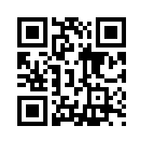
Diversity ~ Equity
What are your thoughts on diversity and equity?
How are these two terms related in regards to education?
Why is this important?
http://tinyurl.com/padletILN

Slide 32
Texas vs Region One Data
Student Group | Region One | State
English Language Learners | 36.9% (158,915) | 18.9% (1,010,168)
Students with Disabilities | 7.81% (33,680) | 8.8% (467,611)
Migrant Students | 4.06% (17,503) | 0.5% (30,948)
Economically Disadvantaged | 85.1% (366,473) | 59% (3,155,117)
Gifted and Talented | 8.42% (36,304) | 7.8% (415,641)
15%
7%
57%
12%
9%
ALL 431,028 5,343,834
©2018 Region One Education Service Center

Slide 33
The Power of acceleration
Remediation vs Acceleration

Slide 34

The Power of Acceleration: Scenario 1
50 mph
25 mph

Slide 35
The Power of Acceleration: Scenario 1
Gap will widen
50 mph
25 mph

Slide 36
The Power of Acceleration: Scenario 2
50 mph
50 mph

Slide 37
The Power of Acceleration: Scenario 2
Gap will remain the same
50 mph
50 mph

Slide 38
The Power of Acceleration: Scenario 3
50 mph
75 mph

Slide 39
The Power of Acceleration: Scenario 3
Gap will eventually close
50 mph
75 mph

Slide 40
ELL Progress
Typical Native Speaker
50th percentile in L1
One year progress = 10 months
7
6
5
4
3
2
English Learners
25th percentile in L2
1+ year progress = 10 months
1
(Thomas & Collier, 2001)
http://www.crede.ucsc.edu/research/llaa/1.1_final.html

Slide 41
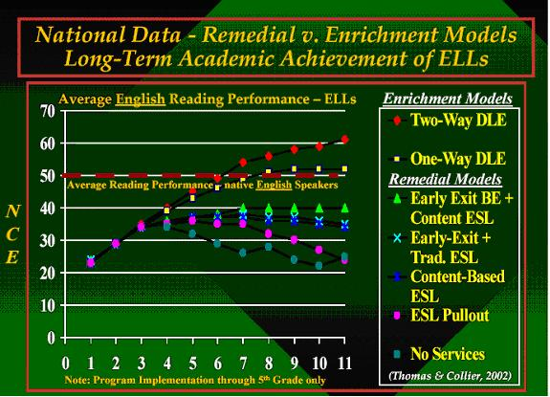
W. Thomas and V. Collier, 2002

Slide 42
ELL + GT = Equity

Slide 43
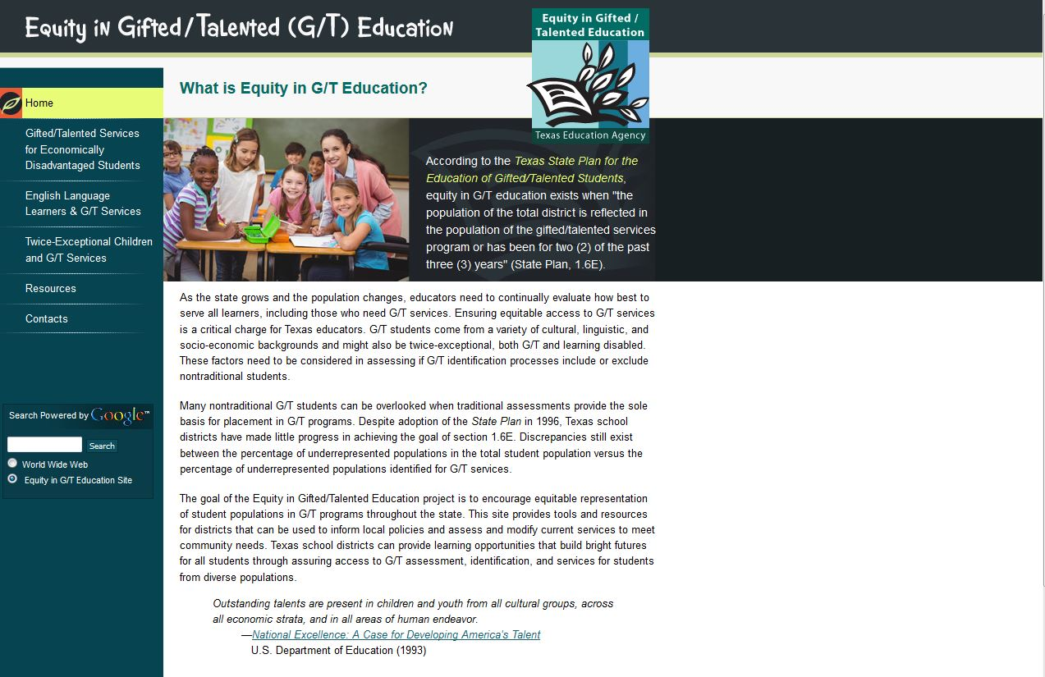
www.gtequity.org

Slide 44
Jigsaw Reading

Slide 45
Jigsaw Reading
Identifying ELLs in Gifted and Talented Programs
By Sam Savage
Introduction (Paragraphs 1-3)
Introduction (Paragraphs 4-6)
The Role of Public Schools
Use of IQ Tests
Recommendations for Identifying GT ELLs
Recommendations for Future Research

Slide 46
Comparison of Attributes of
Gifted/Talented Students
and Gifted/Talented Students
from Poverty

Slide 47
Comparison of Attributes of Gifted/Talented Students and Gifted/Talented Students from Poverty
Attribute | Gifted/Talented (Kingore, 1993) | Gifted/Talented from Poverty (Slocumb & Payne, 2000)
Advanced language | Displays advanced vocabulary Uses complex sentences effectively Naturally uses metaphors and analogies to express relationships | Limits vocabulary to casual register Lacks cause and effect relationships in sentence structure Uses figurative language to reflect comparisons to people and entertainers

Slide 48
Comparison of Attributes of Gifted/Talented Students
and Gifted/Talented Students from Poverty
Attribute | Gifted/Talented (Kingore, 1993) | Gifted/Talented from Poverty (Slocumb & Payne, 2000)
Perspective | Displays an ability to understand and incorporate unexpected or unusual points of view through oral language, writing, manipulatives, and/or art | Incorporates unexpected or unusual points of view through oral language and manipulatives and art (may not do so in writing)

Slide 49
Comparison of Attributes of Gifted/Talented Students
and Gifted/Talented Students from Poverty
Attribute | Gifted/Talented (Kingore, 1993) | Gifted/Talented from Poverty (Slocumb & Payne, 2000)
Sensitivity | Is intensely sensitive to the needs of others Demonstrates a strong sense of justice and sets high standards for self and others | Demonstrates a strong sense of justice as defined by poverty Has fairness issues Identifies with the anti-hero; sees anti-hero as a victim

Slide 50
Comparison of Attributes of Gifted/Talented Students
and Gifted/Talented Students from Poverty
Attribute | Gifted/Talented (Kingore, 1993) | Gifted/Talented from Poverty (Slocumb & Payne, 2000)
Accelerated learning | Demonstrates mastery and an ability to learn and understand material and concepts beyond the facts and knowledge typical and expected for that age group | Learns quickly when shown how to do things that he/she considers meaningful

Slide 51
Comparison of Attributes of Gifted/Talented Students
and Gifted/Talented Students from Poverty
Attribute | Gifted/Talented (Kingore, 1993) | Gifted/Talented from Poverty (Slocumb & Payne, 2000)
Sense of humor | Demonstrates understanding of higher level of humor; applies a finely developed sense of humor, either through production of jokes, riddles, puns, or other humorous effects or through understanding of the subtle humor of others | Applies a finely tuned sense of humor, creates original jokes Often reflects imitations of people and events humorously Tells stories and uses casual register in colorful ways Mimics accurately

Slide 52
Comparison of Attributes of Gifted/Talented Students
and Gifted/Talented Students from Poverty
Attribute | Gifted/Talented (Kingore, 1993) | Gifted/Talented from Poverty (Slocumb & Payne, 2000)
Analytical thinking | Discerns components of a whole Determines relationships and patterns in procedures, experiences, ideas, and/or objects | Is intrigued with the idea of planning, though he/she may lack planning skills Discerns patterns in human behavior, but not necessarily in ideas

Slide 53
Comparison of Attributes of Gifted/Talented Students
and Gifted/Talented Students from Poverty
Attribute | Gifted/Talented (Kingore, 1993) | Gifted/Talented from Poverty (Slocumb & Payne, 2000)
Meaning motivated | Shows curiosity, inner drive, and thorough, independent understanding Asks penetrating questions Demonstrates extensive memory | Is curious, independent Asks questions focused on relationships Has an extensive memory about people and conversations Questions issues related to fairness and/or importance

Slide 54

Varied Faces of Giftedness http:/www.gtequity.org/docs/opt/varied_faces.pdf

Slide 55

ocrdata.ed.gov
How does your district compare to the Region?
What inequities exist in your GT population?

Slide 56
Reflection
If we don’t provide GT services to the best and the brightest from this rapidly growing population, where will the leadership and role models come from?

Slide 57
Session Objectives
Content Objective
Today I explored the differences between remediation and acceleration. I also reflected on how equity plays a role in GT programs.
Language Objective
Today I discussed with my peers the differences between remediation and acceleration. I also created a plan of action to ensure equitable services in our GT program.

Slide 58
Exit Tickets
Write a “Tweet” about something you learned today (120 characters or less).
Don’t forget to hash-tag it!

Slide 59
Mil gracias
Karina E. Chapa, M.Ed.
Language Proficiency, Biliteracy and Cultural Diversity Director
kchapa@esc1.net
Facebook: Region One ESC Bilingual
Twitter @esc1bilingual @bilingualpride

